Slide 1

PROJECT WORK IN MACHINE LEARNING CREDIT CARD FRAUD DETECTION
Professor
Claudio Sartori
Presented By
Yellam Naidu Kottavalasa
Matricola: 0000985387

Slide 2
ABSTRACT
It is vital that credit card companies can identify fraudulent credit card transactions.
so that customers are not charged for items that they did not purchase.
This problems can be tackled with Data Science and its importance, along with Machine Learning.
Credit Card Fraud Detection is a typical sample of classification.

Slide 3
Contents
Introduction
Project Pipeline
Data Collection
Analyzing Data
Preprocessing
Model Creation
Evaluation of Models
Conclusion

Slide 4
Introduction
Unauthorized and unwanted usage of an account.
Necessary prevention measures can be taken.
Protect against similar occurrences in the future.
Fraud detection involves monitoring the activities of populations of users in order to estimate, perceive or avoid objectionable behavior, which consists of fraud, and defaulting.

Slide 5
Project Pipeline
Data Collection
Analyzing Data
Univariate Analysis
Bivariate Analysis
Data Preprocessing
Model Creation
Logistic Regression
Decision Tree
Random Forest
Evaluation Of Models
Accuracy
Precision
Recall
Confusion Matrix

Slide 6
Data Collection
Data collection is the systematic approach.
Gathering and measuring information from a variety of sources.
Containing 12,96,675 transactions of both legitimate and fraud transactions.
It covers credit cards of 1000 customers.
a pool of 800 merchants.
Test
Train

Slide 7
Analyzing Data
Process of inspecting, transforming, and modeling data.
Discovering useful information.
Here the data can be visualized in two ways. They are
Analyzing Data
Univariate Analysis
Bivariate Analysis
Univariate Analysis
Bivariate Analysis

Slide 8
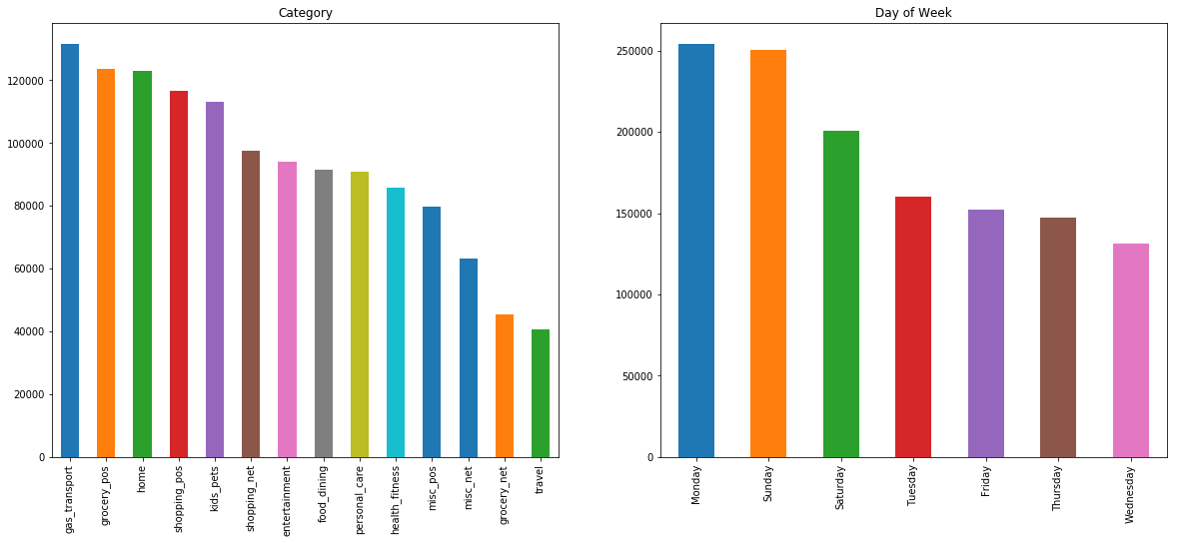
Project analysis slide 3
Univariate Analysis
To enumerative properties as well as a descriptive summary.
gas_transport of the category has the highest credit card transactions.
Sunday and Monday of the week have the highest credit card transactions.
Notes:
8

Slide 9
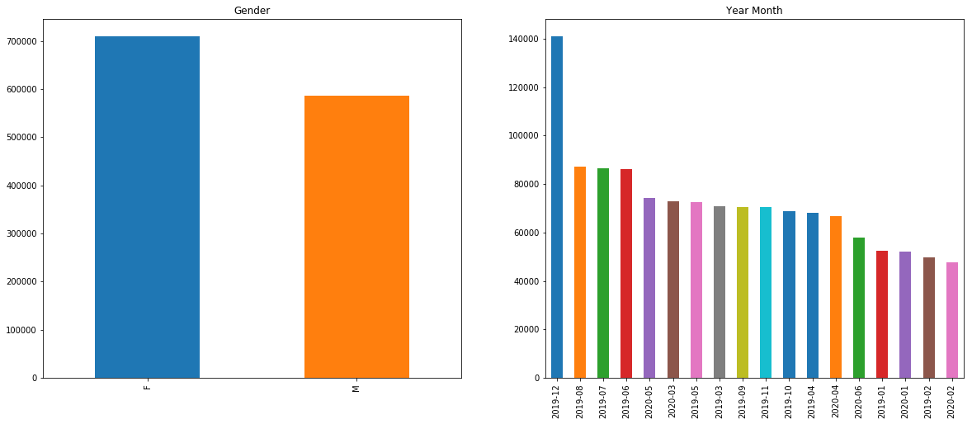
Females are done the more Credit card transactions compared to Male.
Highest number of transactions are in the month of December.
Lowest number of transactions happens in February month.

Slide 10
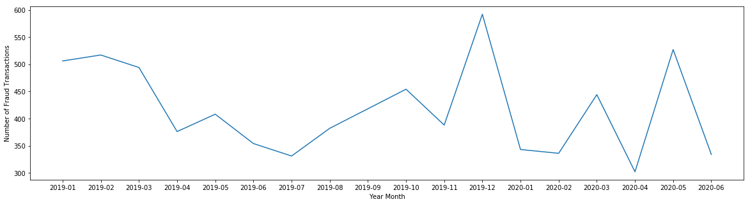
Project analysis slide 4
Bivariate Analysis
kind of empirical relationship between two variables.
Specifically, the dependent vs independent Variables.
More fraud transactions are in the December month of 2019 and the lowest fraud transactions in April month of 2020.
Notes:
10

Slide 11
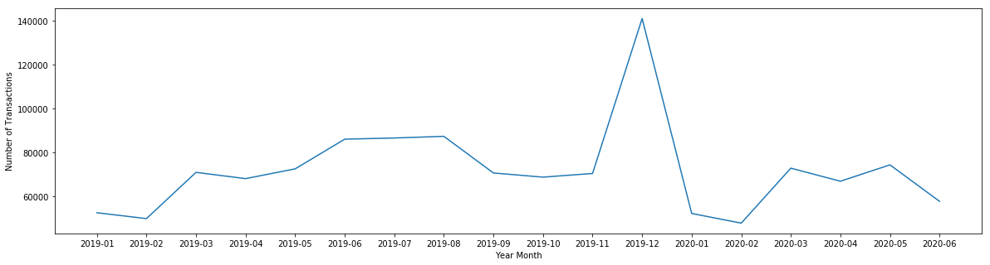
Plotting between the year month and number of transactions.
More number of transactions are in the December month of 2019 and the lowest transactions in February month of 2020.

Slide 12
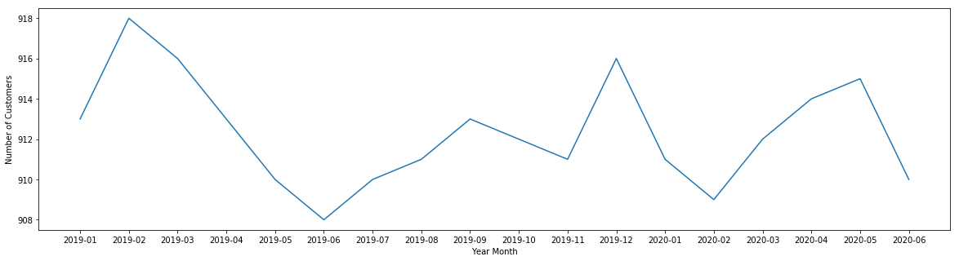
Plotting between the year month and number of Customers.
More number of customers are in the February month of 2019 and the lowest number of customers in June month of 2019.

Slide 13



Data Preprocessing
Data normalization is applied to some
To make model training less sensitive to the scale of features.
one-hot encoding can be applied to the integer representation
new binary variable is added for each unique integer value.
The Dataset is highly imbalanced
Oversampling involves randomly selecting examples from the minority class, with replacement, and adding them to the training dataset.

Slide 14
Project analysis slide 8
Model Creation
we can try different models.
Desired level of performance on the given dataset.
Logistic Regression
Logistic regression is a supervised learning classification algorithm
Predict the probability of a target variable.
Two possible classes.
Relationship between one dependent binary variable and one independent binary variable
Notes:
14

Slide 15
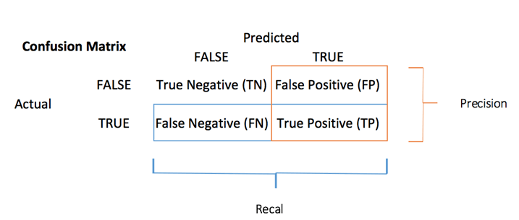
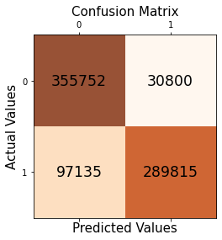
Evaluation of Logistic Regression Model
Confusion Matrix:
Compares the actual target values with those predicted by the machine learning model.
Model Accuracy:
Machine learning model performance metric.
Ratio of true positives and true negatives to all positive and negative observations.
Accuracy Score = (TP + TN)/ (TP + FN + TN + FP)
The accuracy Score of the Logistic Regression Model is 83.46 %

Slide 16
Decision Tree Classification
Supervised learning technique
both classification and Regression problems.
Preferred for solving Classification problems.
It is a tree-structured classifier
Internal nodes represent the features of a dataset, branches represent the decision rules, and each leaf node represents the outcome.

Slide 17
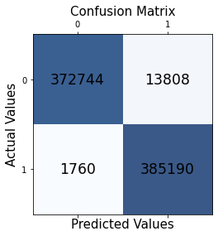
Evaluation of Decision Tree Classification Model
The confusion matrix predicts more True positives ( TP = 385190 ) values.
385190 positive class data points were correctly classified by the model.
The accuracy Score of the Decision Tree Classification Model is 97.98 %

Slide 18
Random Forest Classifier
Supervised learning algorithm.
Most flexible and
Easy to use algorithm.
Creates decision trees on randomly selected data samples, gets prediction from each tree.
selects the best solution by means of voting.
It also provides a pretty good indicator of the feature importance.

Slide 19
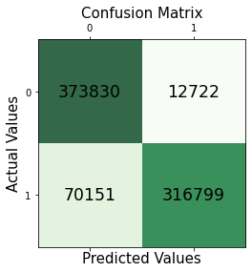
Evaluation of Random Forest Classification Model
The confusion matrix predicts more True positives ( TP = 316799 ) values.
316799 positive class data points were correctly classified by the model.
The accuracy Score of the Decision Tree Classification Model is 89.28 %

Slide 20
Conclusion
An act of criminal dishonesty.
the machine learning can be applied to get better results in fraud detection.
Decision Tree Classifier gives the highest accuracy i.e., 97.98%
The precision is also high of decision tree classifier it measures the count of true positives in a correct manner out of all positive predictions made.
The recall of the Decision tree classifier is more out of the other models, it is the count of true positives in the correct manner out of all the actual positive values.

Slide 21
Thank You

